Slide 1
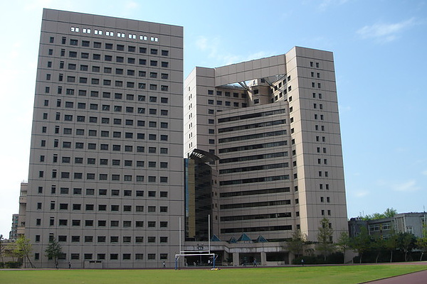
Election Study Center
Since 1989

Slide 2
About Election Study Center (ESC)
Since 1983, Professor Lai Fei-lung and Chen Yi-yen in Nat’l Chengchi University (NCCU) have began doing research on electoral behavior.
In 1989, ESC was officially founded by Professor Lai and Chen. The first director is Professor Chen.
In Taiwan, it is the only one institute that has full-time faculty focus on election study.

Slide 3
Our Missions
Study and document election systems and electoral behavior
Collect election laws and regulations
Promote interdisciplinary research and seek solutions to major problems
Conduct opinion polls on major public policies

Slide 4






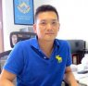

Research Fellows
ESC has seven research fellows who hold joint appointment with Political Science, National Development, East Asian Studies of NCCU, and one from the Institute of Political Science, Academia Sinica.
Chia-hung Tsai
Ching-hsin Yu
Su-feng Cheng
Nathan Batto
Chi Huang
Lu-huei Chen
Eric Chen-hua Yu
Tsun-han Tsai

Slide 5
Recent Major Publications
Mixed-member Electoral Systems in Constitutional Context: Taiwan, Japan, and Beyond
Edited by Nathan Batto, Chi Huang, Alexander C. Tan (Canterbury, NZ), and Gary W. Cox (Stanford)
Published by University of Michigan Press in 2016
The Taiwan Voter
Edited by Christopher Achen (Princeton) and Teh-Yu Wang (Illinois State)
Published by University of Michigan Press in 2017

Slide 6
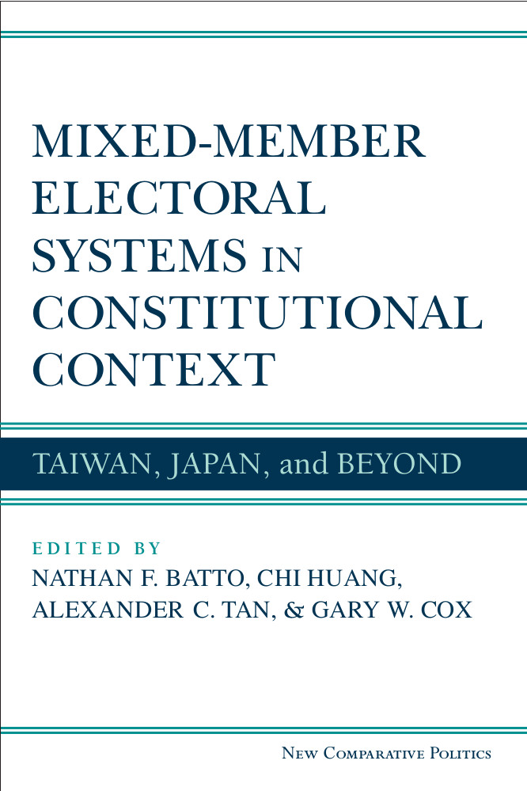
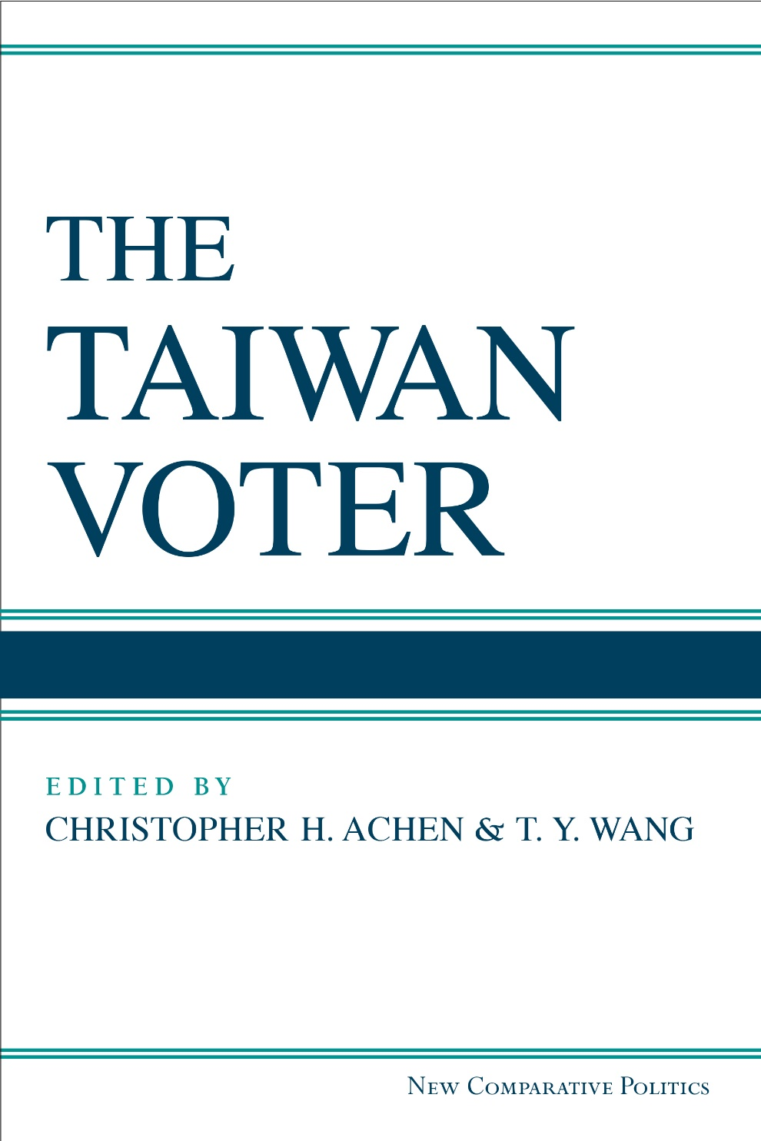

Slide 7
What We Do
Data collection:
Individual-level data: conducting face-to-face, telephone, and Internet surveys to study political behavior and public opinions.
Aggregate-level Data: collecting election statistics back to the 1960s.
Time-series Data: data points drawn from individual-level data
Journal of Electoral Studies: core political science journal in Taiwan
Institute for Political Methodology: co-founded by Professor Chi Huang in 2001 and based in the Institute of Political Science, Academia Sinica.

Slide 8
Individual-level Data
ESC conducts pre- and post-election surveys since the 1990s.
We joined the Taiwan’s Election and Democratization Study (TEDS) led by Professor Chi Huang since 2000.
ESC became and has maintained the headquarter of TEDS since 2012.
ESC supports Taiwan Institute for Governance and Communication Research (TIGCR). It is founded by Professor Chi Huang and Professor Ching-ching Chang from College of Communication.
We also conduct surveys on civic consciousness, national identity, socialization, and national security commissioned by government and academics.

Slide 9
TEDS 2016-2020
Quarterly telephone survey on presidential popularity: Combing land lines and cellphone samples Face-to-Face Interview of 2018 local and 2020 presidential and legislative elections: Address-based sampling Internet survey experiments: Call for proposals twice a year

Slide 10
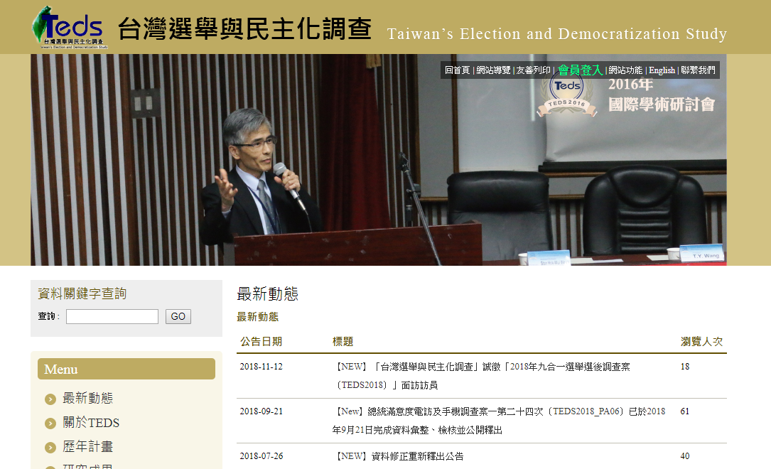

TEDS website and award by MOST

Slide 11
TEDS data archived by ICPSR
University of Michigan included TEDS in the ICPSR database (ICPSR 35094)

Slide 12
Aggregate-level Data
ESC works with the Central Election Commission, sorting out election statistics back to the 1960s.
Professor Chi Huang founded and guided the Taiwan’s Political Geography Information System (TPGIS) to visualize election outcomes on maps.

Slide 13
Taiwan’s Political Geographic Information System, TPGIS
Website (English): http://tpgis.nccu.edu.tw/NccuEng/

Slide 14
Legislative elections
SF Ratio,
1992–2004
SNTV
Legislative
elections
SF Ratio,
2008–2016
SMD
Source: Huang, Chi. 2017. “Electoral System Change and Its Effects on the Party System in Taiwan.” Chapter 10 in The Taiwan Voter, eds. Christopher H. Achen and T.Y. Wang. Ann Arbor: University of Michigan Press.

Slide 15
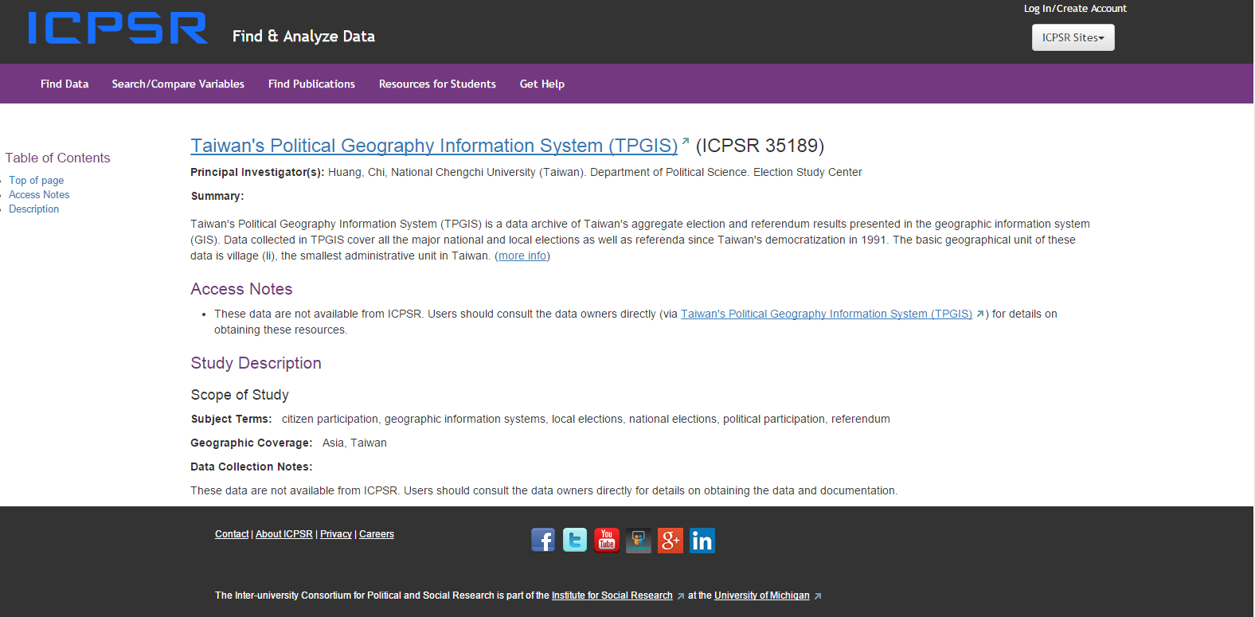
TPGIS collected by ICPSR
University of Michigan included TPGIS in the ICPSR database (ICPSR 35189).

Slide 16
Time-series Data
Aggregating the data points from survey data to create time-series of Taiwanese/Chinese identity, partisanship, and unification/independence issue position.
TEDS‘ quarterly polls generates quarterly presidential approval rates

Slide 17
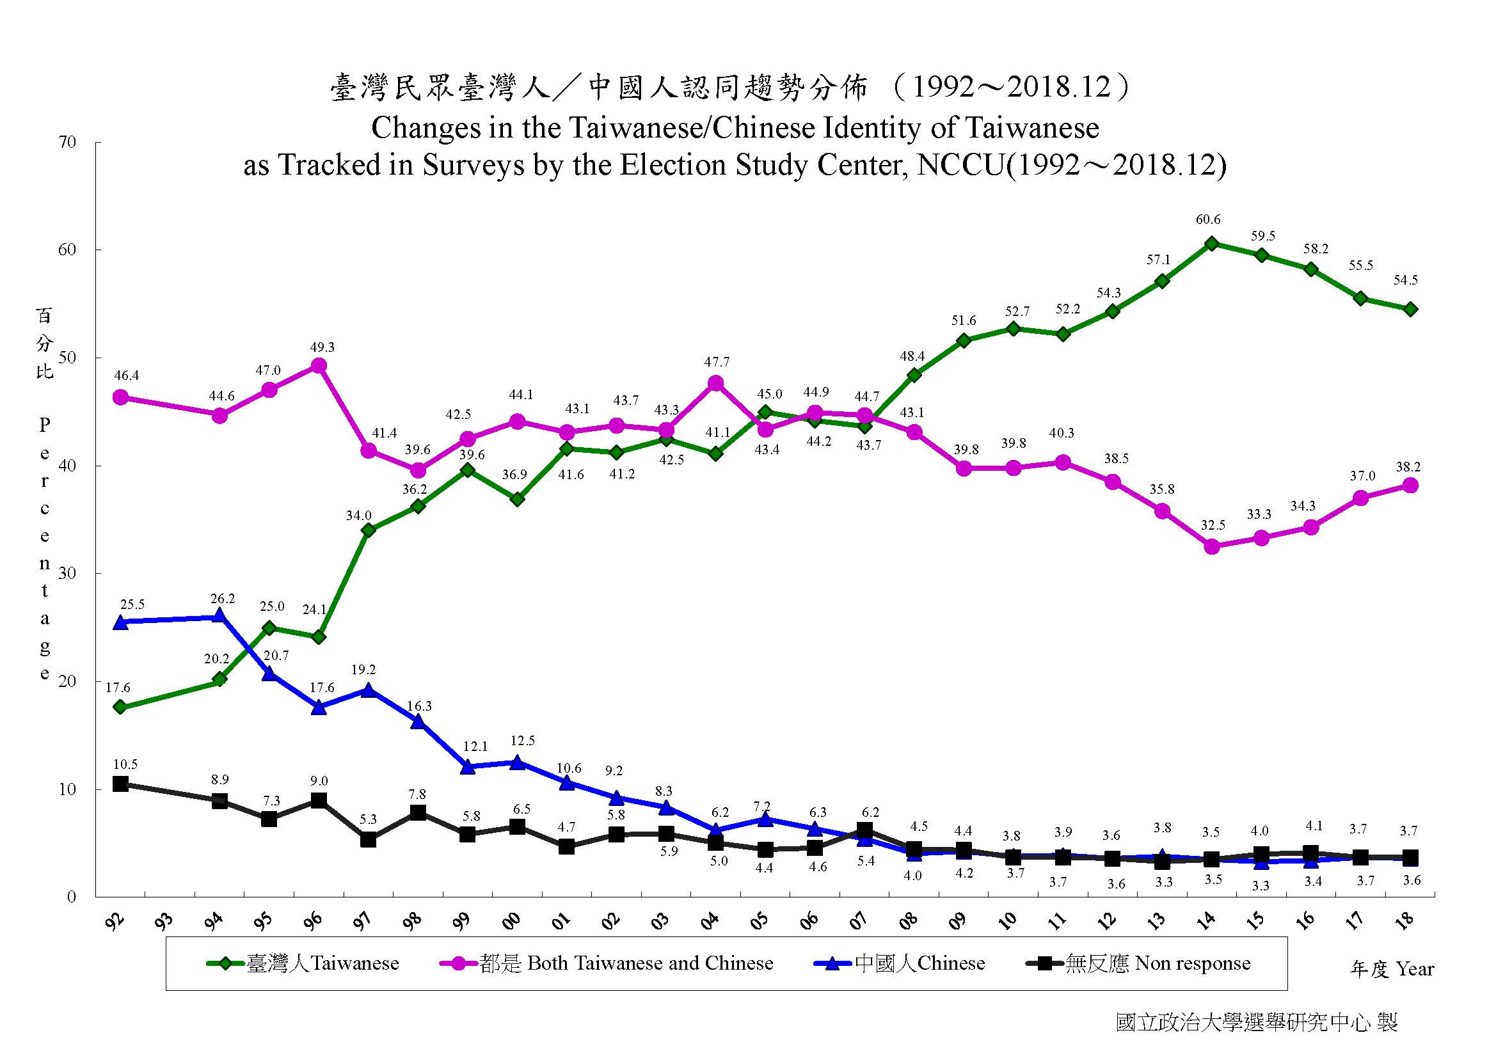

Slide 18
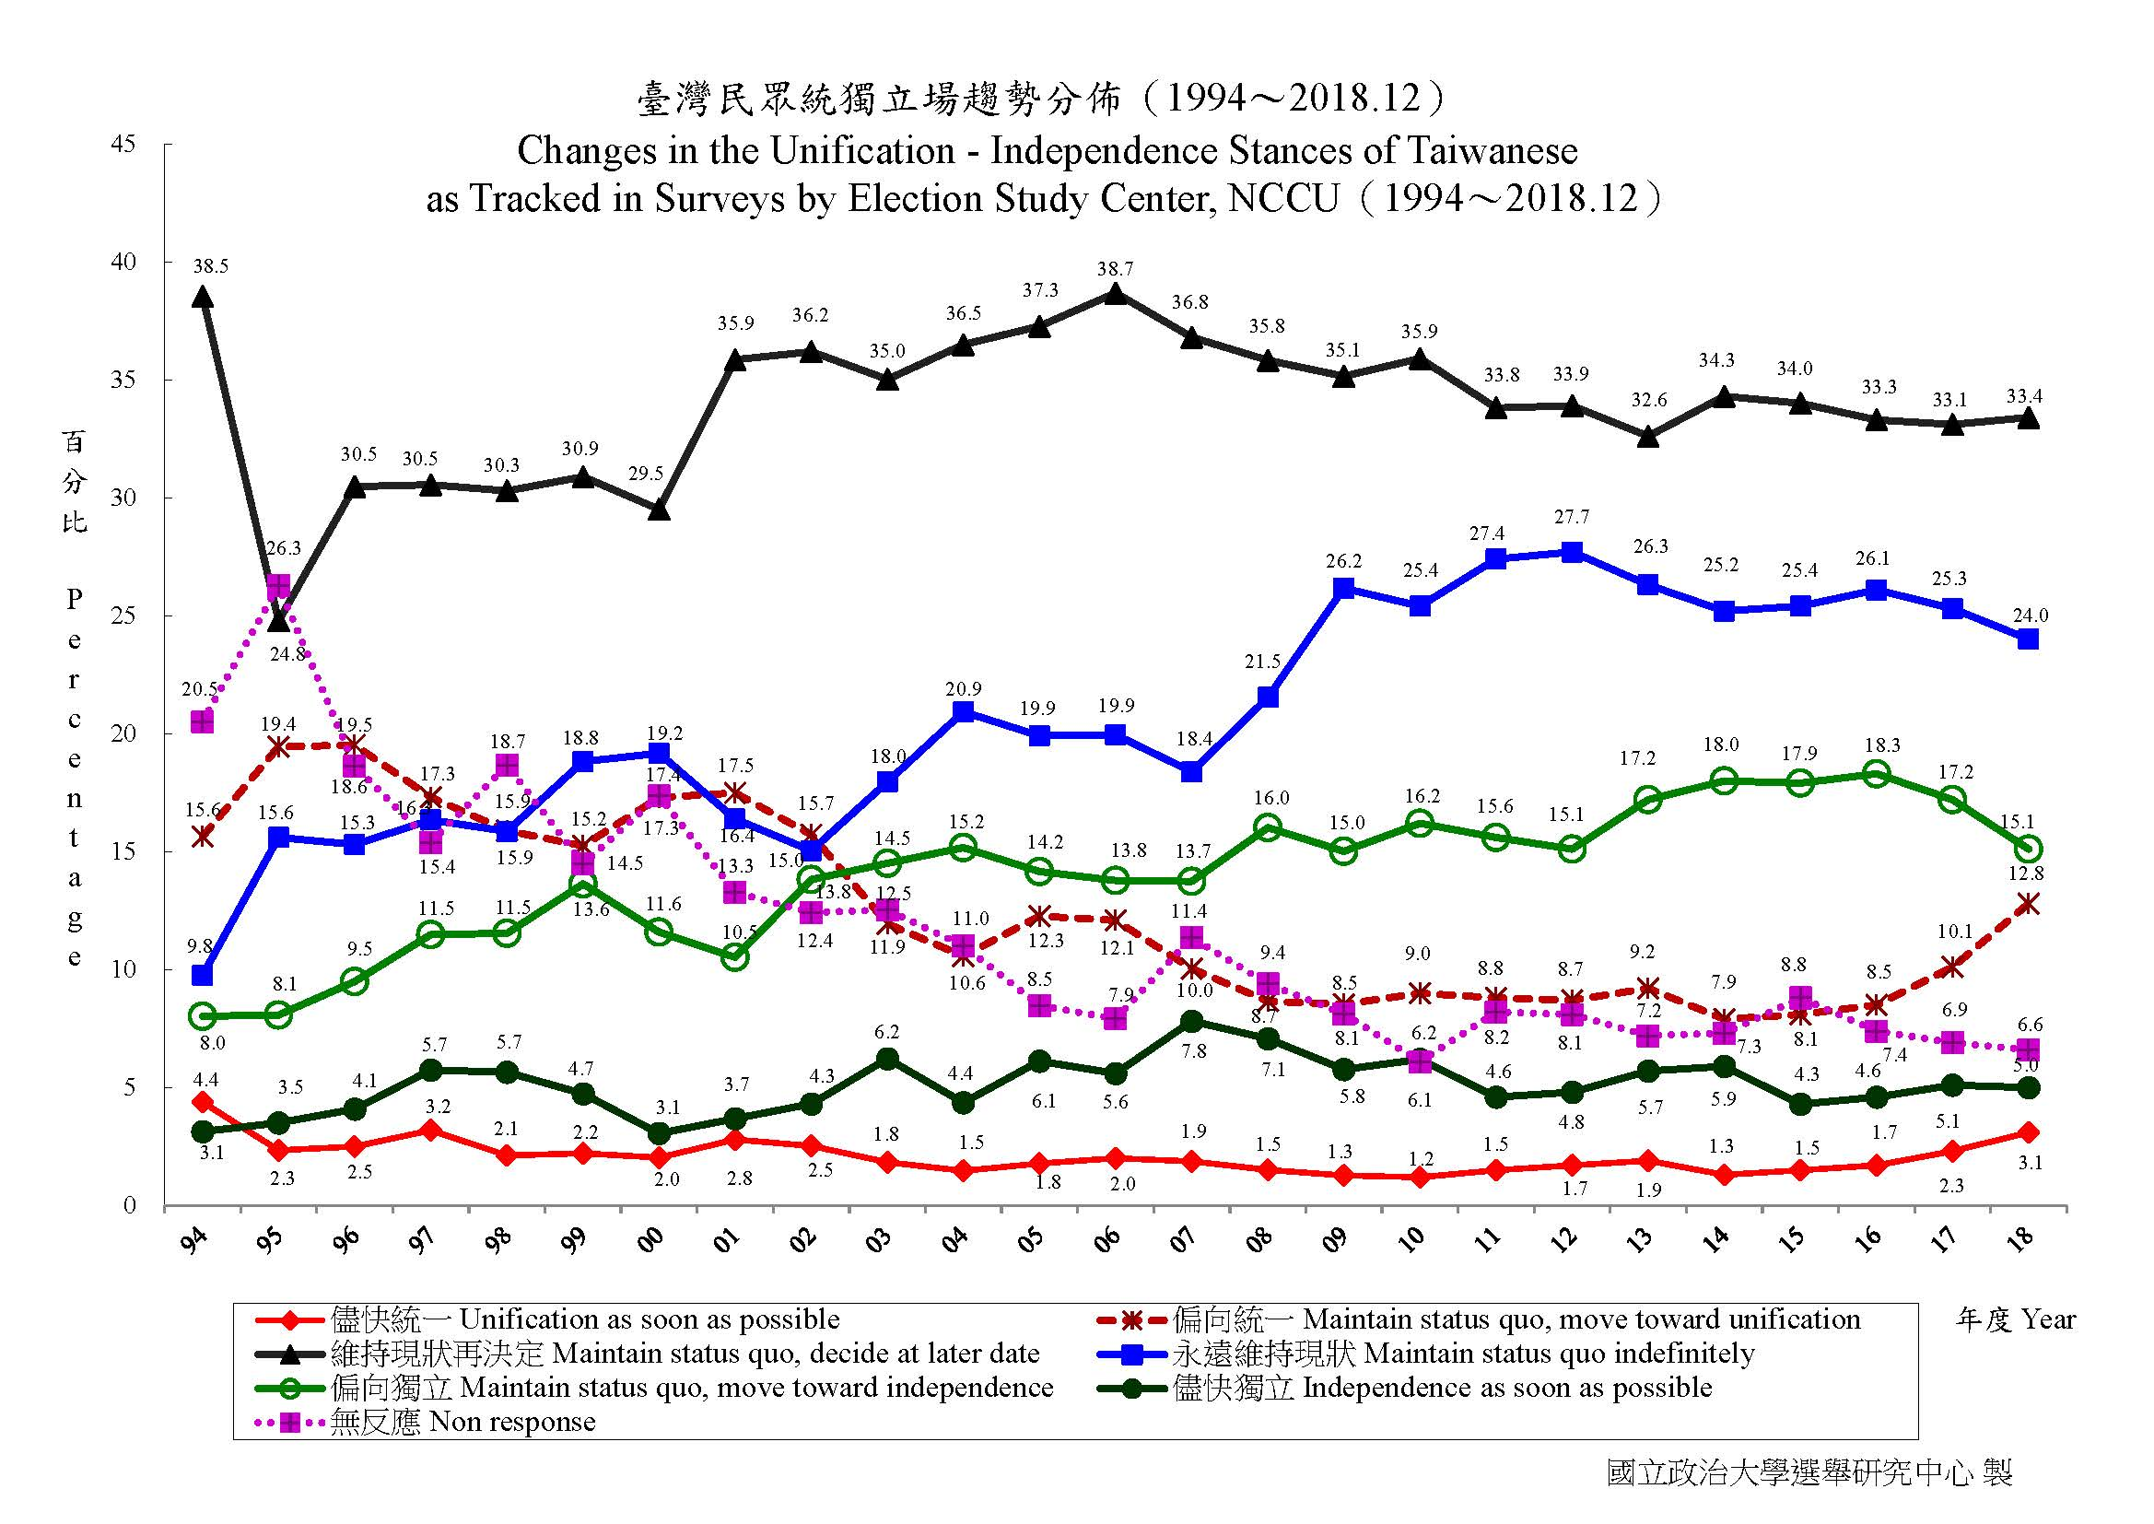

Slide 19
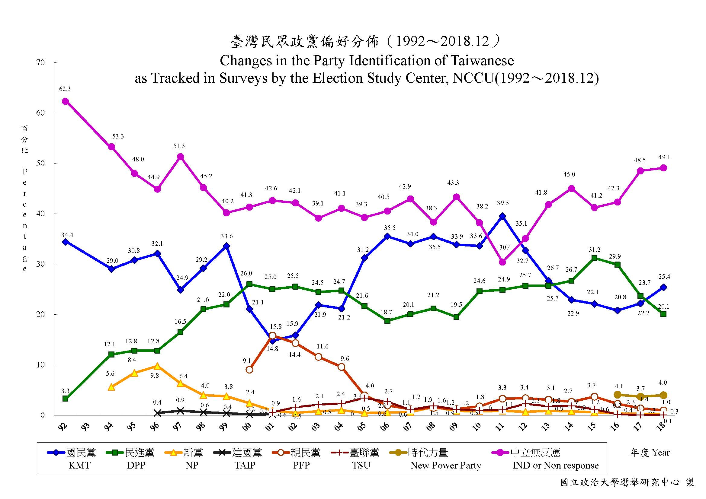

Slide 20
TEDS Quarterly Telephone Surveys on Presidential Approval Rates
Figure 1 President Ma’s Approval Rates: Sep. 2012 to Mar. 2016
Source: Huang (2016).

Slide 21
TEDS Quarterly Telephone Surveys on Presidential Approval Rates
Figure 2 President Tsai’s Approval Rates: Jun. 2016 – Dec. 2018
Source: Huang (2018).

Slide 22
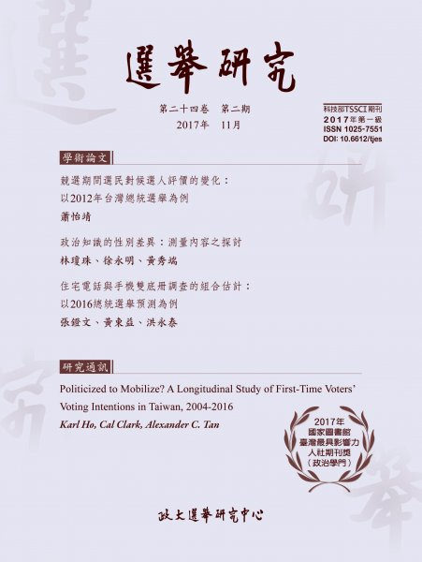
Journal of Electoral Studies
Edited by ESC since 1994
Ranked as one of the most influential journals of political science in Taiwan by National Central Library in 2016, 2017, and 2018.
Published semiannually
Will be indexed by EBSCO soon

Slide 23
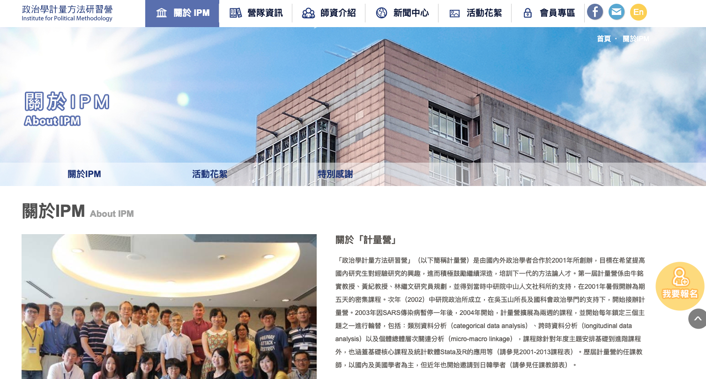
Institute for Political Methodology (IPM)
Founded by Professor Chi Huang and many distinguished scholars in 2001, IPM has trained 20 domestic and international graduate students on advanced methods, such as categorical data analysis, causal inference, and machine learning every summer.

Slide 24
Q & A

